Slide 1
Emerging Databases

Slide 2
Active Databases
An active database is a database that includes an event-driven architecture (often in the form of ECA rules) which can respond to conditions both inside and outside the database.
Possible uses include security monitoring, alerting, statistics gathering and authorization.
Most modern relational databases include active database features in the form of database triggers.

Slide 3
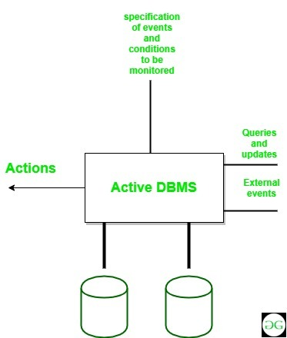
Active Databases

Slide 4
Active Databases
Active Database is a database consisting of set of triggers
If the trigger is active then DBMS executes the condition part and then executes the action part only if the specified condition is evaluated to true. It is possible to activate more than one trigger within a single statement.
In such situation, DBMS processes each of the trigger randomly. The execution of an action part of a trigger may either activate other triggers or the same trigger that Initialized this action. Such types of trigger that activates itself is called as ‘recursive trigger’

Slide 5
Features of Active Database
It possess all the concepts of a conventional database i.e. data modelling facilities, query language etc.
It supports all the functions of a traditional database like data definition, data manipulation, storage management etc.
It supports definition and management of ECA rules.
It detects event occurrence.
It must be able to evaluate conditions and to execute actions.
It means that it has to implement rule execution.

Slide 6
Advantages
Enhances traditional database functionalities with powerful rule processing capabilities.
Enable a uniform and centralized description of the business rules relevant to the information system.
Avoids redundancy of checking and repair operations.
Suitable platform for building large and efficient knowledge base and expert systems.

Slide 7
What is Deductive Database ?
A Deductive Database system is a database system that includes capabilities to define “Rules”, which can deduce additional information from the facts that are stored in a database
Mathematical logic is a part of the theoretical foundation for the Deductive Database, that is why it is also called a “logic database”.

Slide 8
DDB uses a declarative language
Declarative Language means a language that defines what a program wants to achieve, rather than one that specifies the details of how to achieve it.
A deduction mechanism within the system can deduce new facts from the database by interpreting these rules.

Slide 9
Types of specifications of DDB
There are two main types of specifications:
Facts
Rules

Slide 10
Facts
Facts are specified as the same way the relations are specified in the Relational Database
Except it is not necessary to include the attribute names.
The meaning of an attribute value in a tuple is determined solely by its position in the tuple

Slide 11
Rules
They specify “virtual relations” that are not actually stored but that can be formed from the facts by applying deduction mechanisms based on the rule specifications.
somewhat similar to relational views, but different in the sense that it may involve recursion

Slide 12
Notations
Deductive database uses Datalog notation, which is a subset of Prolog
Prolog is a language based on logic.
Datalog is a deductive query language similar to Prolog but more suitable for database applications.

Slide 13
Prolog and Datalog notations
The notation used in Prolog/Datalog is based on providing “predicates” with unique names.
A predicate has an implicit meaning, which is stated by the predicate name and a fixed number of arguments.
If the arguments are all constant values, the predicate states that the fact is true.

Slide 14
Prolog convention
All constant values in a predicate either are numeric or are character strings starting with lower case letters only.
Variable names always start with an upper case letter.

Slide 15
Example of notation
SUPERVISE(Supervisor,Supervisee)
Predicate name Arguments

Slide 16
Datalog notation
Datalog program is built from basic objects called “atomic formulas”
This logic-based languages describe the syntax of atomic formulas and identify how they can be combined to form a program.

Slide 17
Built-in predicates
A number of built-in predicates are included in Datalog, which can be used to construct atomic formulas.
Built-in predicates are of two types :
Binary comparison predicates over ordered domains
Comparison predicates over ordered or unordered domains

Slide 18
Interpretations of Rules
Two main alternatives for interpreting the theoretical meaning of rules :
Proof-theoretic
Model-theoretic

Slide 19
Proof-theoretic interpretation
Axioms - the facts and rules to be true statements
Ground Axioms- The facts that are given to be true.
Deductive Axioms- Rules are called deductive axioms, because they can be used to deduce new facts.

Slide 20
Model Theoretic interpretation
For a finite or infinite domain of constant values, we assign to a predicate every possible combination of values as arguments. Then we determine whether the predicate is true or false.

Slide 21
Main Memory Database System (MMDB)
a database management system that primarily relies on main memory for computer data storage
In-memory databases are faster than disk-optimized databases because disk access is slower than memory access, the internal optimization algorithms are simpler and execute fewer CPU instructions.
Accessing data in memory eliminates seek time when querying the data, which provides faster and more predictable performance than disk

Slide 22
Main Memory Database System
Applications where response time is critical, such as those running telecommunications network equipment and mobile advertising networks, often use main-memory databases
A potential technical hurdle with in-memory data storage is the volatility of RAM. Specifically in the event of a power loss, intentional or otherwise, data stored in volatile RAM is lost

Slide 23
ACID support
main memory databases store data on volatile memory devices. In this case, IMDBs can be said to lack support for the "durability" portion of the ACID (atomicity, consistency, isolation, durability) properties
Many IMDBs have added durability via the following mechanisms:
Snapshot files, or, checkpoint images
Transaction logging
Non-volatile random-access memory (NVRAM)
High availability

Slide 24
Semantic Databases
The logical data structure of a database management system (DBMS), whether hierarchical, network, or relational, cannot totally satisfy the requirements for a conceptual definition of data, because it is limited in scope and biased toward the implementation strategy employed by the DBMS.
Therefore, the need to define data from a conceptual view has led to the development of semantic data modeling techniques.

Slide 25
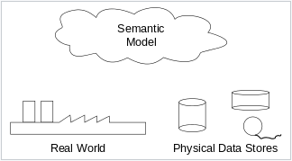
Semantic Databases

Slide 26
Semantic Databases
Techniques to define the meaning of data within the context of its interrelationships with other data. The real world, in terms of resources, ideas, events, etc., are symbolically defined within physical data stores.
A semantic data model is an abstraction which defines how the stored symbols relate to the real world.
Thus, the model must be a true representation of the real world.

Slide 27
Semantic Databases
According to Klas and Schrefl (1995), the "overall goal of semantic data models is to capture more meaning of data by integrating relational concepts with more powerful abstraction concepts known from the Artificial Intelligence field. The idea is to provide high level modeling primitives as an integral part of a data model in order to facilitate the representation of real world situations"

Slide 28
Applications
Planning of Data Resources
Building of Shareable Databases
Evaluation of Vendor Software
Integration of Existing Databases

